Slide 1
C# fundamentals and OOPS concepts
Team A members :
Tejal Gupta
Sandhya Bukya
Gurubani Gulati
Meenu
Gaurav Bajaj
Friday, September 4, 2020

Slide 2
Fundamentals of C#
What is C#??
What we can do with C#??
C# is a simple, modern, general-purpose, object-oriented programming language developed by Microsoft within its .NET initiative led by Anders Hejlsberg.
C# is widely used for developing desktop applications, web applications and web services.
It is used in creating applications of Microsoft at a large scale.
It is one of the top 3 languages to learn.
It can be compiled on a variety of computer platforms as it is a part of .Net Framework.
It comes with the simple and easy to learn syntax and derived from C and C++.
C# is the standard industry language and has a framework that is much easier to learn than C++. Many development houses are moving closer to C# because of the time it saves.

Slide 3
Understanding the basic syntax of C#
using System; namespace HelloWorldApplication { class HelloWorld { static void Main(string[] args) { /* my first program in C# */ Console.WriteLine("Hello World"); ; } } }
The using keyword is used to include the System namespace in the program.
A namespace is a collection of classes. The HelloWorldApplication namespace contains the class HelloWorld.
The lines within /* */ are ignored by the compiler.
This statement causes the message "Hello, World!" to be displayed on the screen.

Slide 4
VARIABLES
Static Variables or Class Variables
Constant Variables
Readonly Variables
Local variables
Instance variables or Non – Static Variables
Naming Standard
Do not use underscores (_) for local variable names.
Do not use Hungarian notation to name variables.
All variables should use camel casing.
Do not use variable names that resemble keywords.
All member variables must be prefixed with underscore (_) so that they can be identified from other local variables
VARIABLES
DATA TYPE | VARIABLE
String | prodDesc
Int | Qty
Float | price
Float | disc
Real Time Example : "The Receipt"

Slide 5
CONDITIONS
SYMBOL | NAME
< | Less Than
> | Greater Than
= | Equal to
<= | Less than or Equal to
>= | Greater than or equal to
! | Not
!= | Not Equal to
&& | AND
|| | OR
CONDITIONAL LOGIC
IF
ELSE
ELSE IF
SWITCH STATEMENT
CONDITIONS
CONDITIONAL OPERATOR
switch (prodDesc)
{
Case "Rice" :
disc = 10;
break;
Case "Wheat" :
disc = 5 ;
break;
default :
disc = 0;
}
2
1
if(price >= 100)
disc = 5;
else if (price >= 250)
disc = 15;
else
disc = 0;
Real Time Example : "The Receipt" ​

Slide 6
LOOPS
METHODS
Looping in a programming language is a way to execute a statement or a set of statements multiple times depending on the result of the condition to be evaluated to execute statements. The result condition should be true to execute statements within loops.
1. For loop
2. While loop
3. Do-While loop
Methods(functions) is a block of code which runs only when called.
Information can be passed on to methods in form of Parameters or Arguments.
Methods can also be used return a value.
With method overloading, multiple methods can have same name with different parameters and return type.
int MyMethod(int x) float MyMethod(float x) double MyMethod(double x, double y)
for (initializer; condition; iterator) { //code block }
While(condition) { //code block }
Initialization of the counter variable is done outside the loop and increment/decrement inside loops
do{ //code block } while(condition);

Slide 7
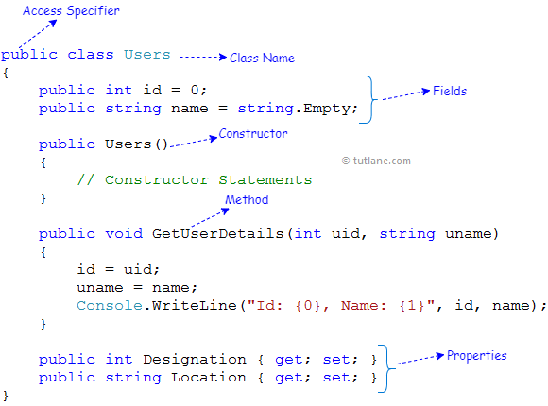
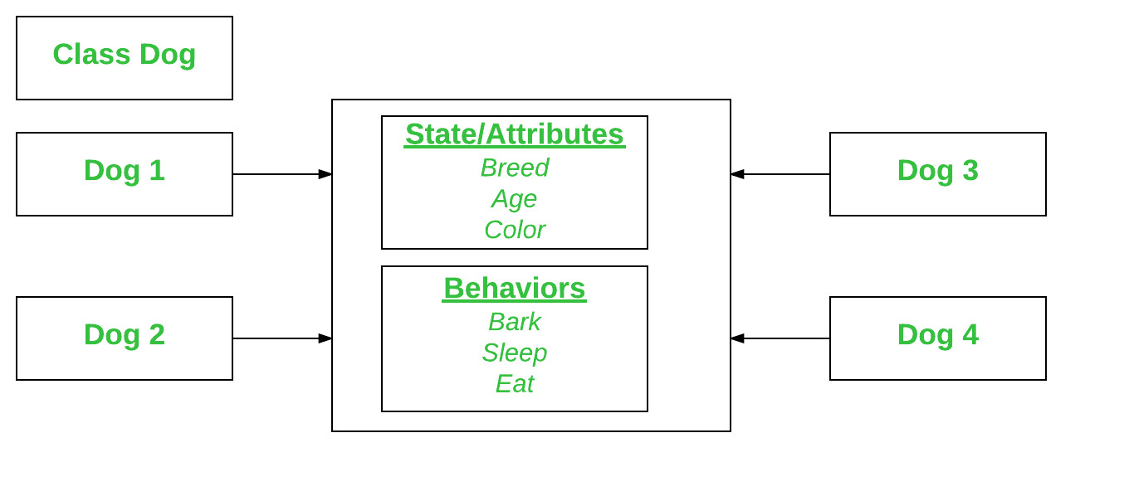
CLASSES
OBJECTS
Class is a blueprint of a specific object. A class combines the fields and methods(member function which defines actions) into a single unit.
An object is a real world entity. It has 3 things:
1. State(attributes)
2. Behaviour(methods)
3. Identity(name of the object)
Dog tuffy=new Dog("Labrador",4, "brown");

Slide 8
OOPs - FOUNDATION
WHEN !
Clean Code
API
Defensive Coding
Object-oriented programming is about creating objects that contain both data and methods.
OOP
"Don't Repeat Yourself" (DRY) principle
Design Pattern
. Net Apps
Domain Driven Design
Faster and easier to execute. Leveraging Reuse
Defining relationship between classes

Slide 9

One can have multiple classes that can be used interchangeably, even though each class implements the same properties or other
OOPS CONCEPT
Hiding the unnecessary details from type consumers
Abstraction
Polymorphism
OOPS
Ability to create new classes based on an existing class.
A group of related properties, methods and other members are treated as single unit or object
Encapsulation
Inheritance

Slide 10
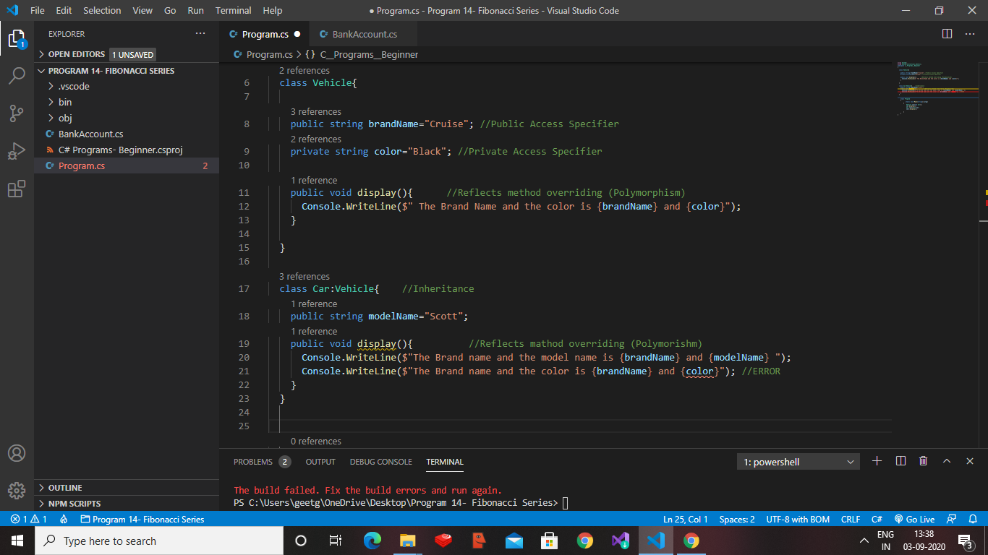
WHAT!
UNDERSTANDING METHOD OVERRIDING CONCEPT WITH A PROGRAM DEMONSTRATION

Slide 11
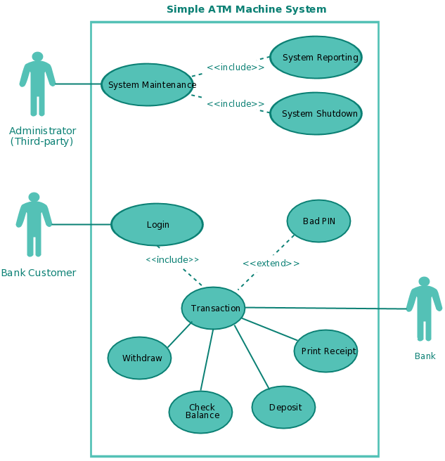
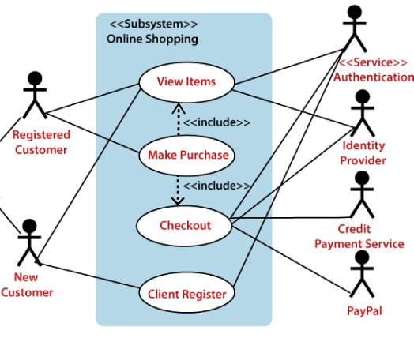
Business use case

Slide 12
THANK YOU

